Slide 1

Cynhadledd Flynyddol 2023
Annual Conference 2023
Mynd i'r afael ag aflonyddu rhywiol rhwng cyfoedion mewn addysg bellach
Tackling peer-on-peer sexual harassment in further education
Llais addysg bellach yng Nghymru | The voice of further education in Wales

Slide 2
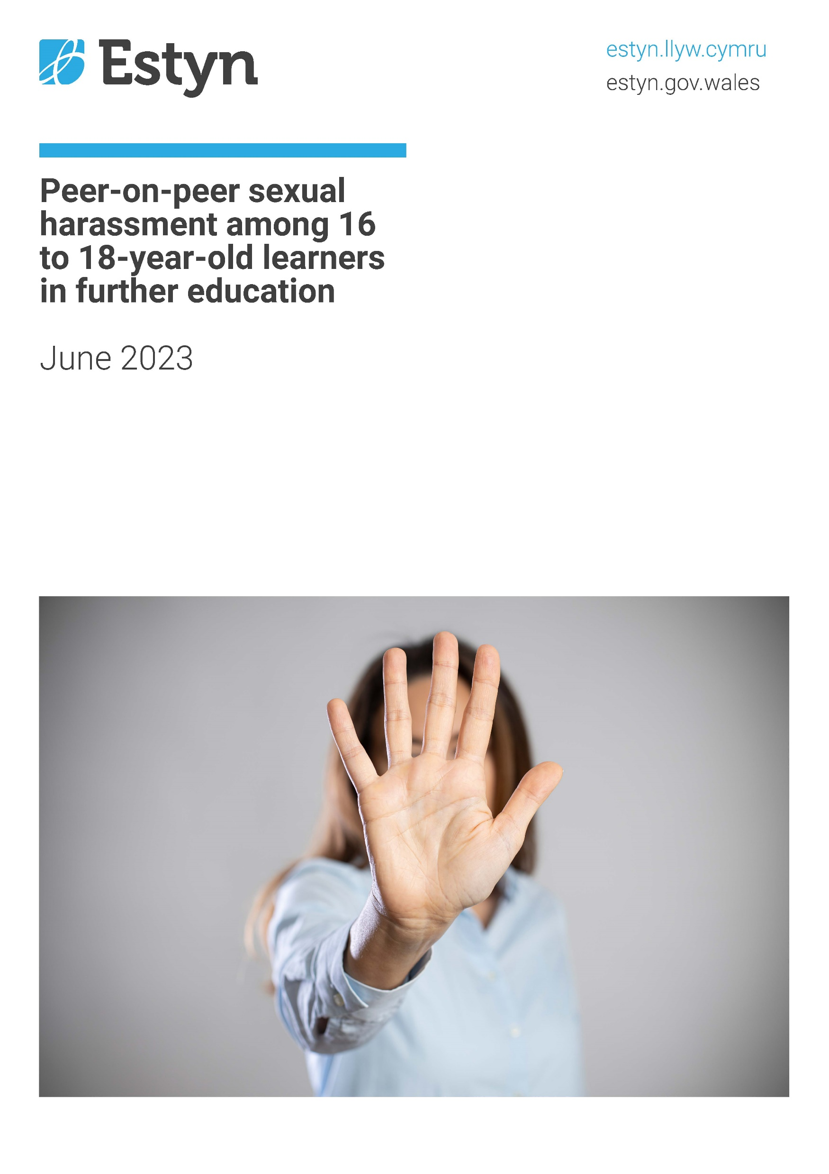

Slide 3

Ian Dickson
Estyn

Slide 4

Key findings from Peer-on-peer sexual harassment among 16-18-year old learners in further education thematic review
In the autumn term of 2022, inspectors undertook in person visits to all twelve further education colleges in Wales to evaluate the incidence of peer-on-peer sexual harassment and review the culture and processes that help protect and support 16 to 18‑year‑old learners in colleges.
We held workshops with learners, spoke to leaders, teachers and support staff in colleges and looked at a wide range of documents relating to existing processes involving potential incidents of sexual harassment.
We found that the issue of peer-on-peer sexual harassment among 16 to 18‑year‑old college learners is complex and widely underreported, with many learners choosing not to, or being unsure how to, report incidents of sexual harassment for a variety of reasons.
Colleges have well established learner disciplinary policies and processes and most deal effectively with the most serious reported cases of alleged peer-on-peer sexual harassment.
College systems for accurate recording and analysis of sexual harassment among learners are underdeveloped. Too often, incidents of sexual harassment are recorded and categorised within generic classifications of bullying.

Slide 5
Key findings
Sexual harassment incidents involve a mix of face‑to‑face and online issues.
Our discussions with learners and staff suggest that learners identifying as female, LGBTQ+ and learners with additional learning needs may be more likely to experience sexual harassment.
Many staff told us they lack confidence and feel that there is a need for more professional development and updates in relation to sexual harassment.
Where colleges have held specific training sessions on addressing sexual harassment, these have helped staff to recognise incidents and address them appropriately.
Overall, there is also a lack of further education specific resources to support college staff in dealing with the issue of peer‑on-peer sexual harassment.
Collaborative work to address these concerns has begun recently but it is too early to evaluate its effectiveness or impact.

Slide 6
Recommendations
The following recommendations should support further education colleges in their work to identify and address issues of peer-on-peer sexual harassment among 16 to 18‑year‑old learners:
Ensure that all learners benefit from opportunities to take part in learning activities and discussions about forming and maintaining healthy relationships
Develop strategies to prevent and tackle misogynistic attitudes and cultures developing among groups of learners
Ensure that all relevant staff members undertake professional learning that enables them to confidently recognise and respond to sexual harassment as well as help learners develop their understanding of healthy relationships
Ensure that all learners feel safe and comfortable in all areas of college buildings, grounds, virtual spaces, and transport
Record, categorise and analyse instances of sexual harassment, assault and abuse in a consistent way that enables leaders to identify trends and take appropriate measures in response

Slide 7
Recommendations
The following recommendations should support the Welsh Government in its work with further education colleges to monitor and address issues of sexual harassment among 16 to 18‑year‑old college learners:
Make clear which aspects of Welsh Government education guidance relating to sexual harassment apply to further education colleges and clarify any differences between requirements in schools and further education colleges
Provide appropriate guidance to colleges to help them adopt a co-ordinated and consistent approach to recording and categorising instances of sexual harassment

Slide 8
Peer-on-Peer Abuse Project
A Welsh Government funded collaborative FE project
Alice Churm
(She/Her)
Equality & Diversity Coordinator
Coleg Cambria
alice.churm@cambria.ac.uk

Slide 9
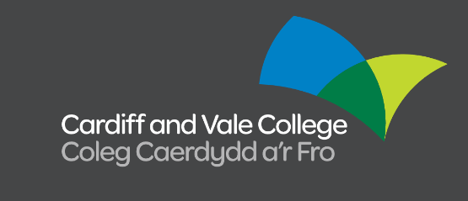





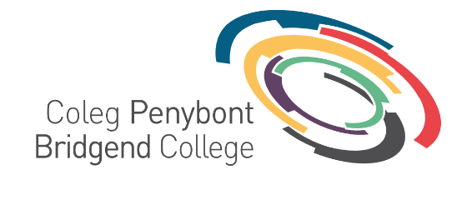
A Collaborative Project

Slide 10
Our Approach
Addressing Peer-On-Peer Abuse as a whole
  Discrimination
  Hate Speech
  Harassment
  Violence
Equality as a core principle
  Identified learner’s protected characteristics
  Analysing how different groups are affected
Aiming to identify and address:
  Extent of incidents of PoPA both experienced and witnessed by learners
  Barriers learners face to reporting
  Learner understanding of support available
  College commitments to tackling PoPA
  Staff awareness of issue

Slide 11
Year One Progress
Learner Survey
  Building off Estyn Report
  Developed in collaboration with Cardiff University
  Distributed amongst seven Welsh colleges
Process Audit
  Identifying key approaches towards PoPA from different institutions
  Recommend standardised approach within the sector
  Compare college processes to learner understanding
Learner and Staff Workshops from Rewise
  Exploring themes of PoPA and emotions
  Songwriting as a tool to explore topics
  Learner workshops inform staff workshops
  Songs to be shared as resource in year two

Slide 12
Key Findings
Experiences of PoPA based on gender or sex was most common
  10.6% of learners disclosed experiencing PoPA based on gender or sex
  The other categories were as follows:
    Ethnicity: 8.5%
    Religion: 6.8%
    Sexual Orientation: 7.0%
    Disability: 3.9%
Most learners are aware of college support for experiences of PoPA
  58% of learners were aware of college support for experience of PoPA
  11% were not aware, and 6% were unsure
Learners aren’t sure about staff awareness, knowledge and proficiency
  48% of learners felt staff were aware of PoPA, and 42% felt staff had proficiency and knowledge to respond to PoPA
  5% felt staff aren’t aware, proficient and knowledgeable and 18% were unsure
College language is not standardised
  Different definitions of terms, and sits within different policies

Slide 13
Defining PoPA
One of our key findings showed that as a sector, we do not have clear definitions of PoPA.
Definitions are important so we can properly identify and tackle the behaviour.
HATE SPEECH
DISCRIMINATION
HARASSMENT
VIOLENCE

Slide 14
Year Two Plans
Trauma Informed Training and Resources
  Utilising a Trauma Informed Approach to develop learning around PoPA
  Three strands planned:
    Understanding PoPA (for all staff)
    Supporting Disclosures (for first line staff)
    What is PoPA? (session plans to be delivered to students)
Reporting Tool
  Investigating a tool / hub where learners can disclose PoPA
  Online space that works alongside the campaign
Raising Awareness
  Campaign to raise awareness with learners to encourage reporting
  Sharing resources for staff and learners
ALN Strand
  Working with Cardiff Met Uni exploring learner perception of issues
  Focusing on neurodiverse and neurotypical learners

Slide 15
Cynhadledd Flynyddol 2023
Annual Conference 2023
Mynd i'r afael ag aflonyddu rhywiol rhwng cyfoedion mewn addysg bellach
Tackling peer-on-peer sexual harassment in further education
Llais addysg bellach yng Nghymru | The voice of further education in Wales

Slide 16


Slide 17

Ian Dickson
Estyn

Slide 18
Prif ganfyddiadau o’r arolwg thematig ar aflonyddu rhywiol rhwng cyfoedion ymhlith dysgwyr 16-18 oed mewn colegau addysg bellach
Yn ystod tymor yr hydref 2022, cynhaliodd arolygwyr ymweliadau wyneb-yn-wyneb â phob un o’r deuddeg coleg addysg bellach yng Nghymru i werthuso cyffredinrwydd aflonyddu rhywiol rhwng cyfoedion ac adolygu’r diwylliant a’r prosesau sy’n helpu i ddiogelu a chefnogi dysgwyr 16 i 18 oed mewn colegau.
Cynhaliom weithdai â dysgwyr, siarad ag arweinwyr, athrawon a staff cymorth mewn colegau, ac edrych ar ystod eang o ddogfennau yn ymwneud â phrosesau presennol a oedd yn cynnwys achosion posibl o aflonyddu rhywiol.
Canfuom fod aflonyddu rhywiol rhwng cyfoedion ymhlith dysgwyr 16-18 oed mewn colegau yn fater cymhleth nad yw’n cael ei gofnodi’n ddigonol, gyda llawer o ddysgwyr yn dewis peidio â rhoi gwybod am achosion o aflonyddu rhywiol neu ddim yn siŵr sut i roi gwybod amdanynt, am amrywiol resymau
Mae gan golegau bolisïau a phrosesau sefydledig ar gyfer disgyblu dysgwyr ac mae’r rhan fwyaf ohonynt yn ymdrin yn effeithiol â’r achosion mwyaf difrifol o aflonyddu rhywiol rhwng cyfoedion y rhoddir gwybod amdanynt.
Nid yw systemau colegau i gofnodi a dadansoddi aflonyddu rhywiol ymhlith dysgwyr yn gywir wedi’u datblygu’n ddigonol. Yn rhy aml, caiff achosion o aflonyddu rhywiol eu cofnodi a’u categoreiddio o fewn dosbarthiadau bwlio cyffredinol

Slide 19
Prif ganfyddiadau
Mae achosion o aflonyddu rhywiol yn cynnwys cymysgedd o faterion wyneb-yn-wyneb ac ar-lein.
Mae ein trafodaethau â dysgwyr a staff yn awgrymu y gallai dysgwyr sy’n ystyried eu hunain yn fenywod, LHDTC+ a dysgwyr ag anghenion dysgu ychwanegol fod yn fwy tebygol o gael profiad o aflonyddu rhywiol.
Dywedodd llawer o staff wrthym nad ydynt yn hyderus a’u bod yn teimlo bod angen mwy o ddatblygiad proffesiynol a diweddariadau yn ymwneud ag aflonyddu rhywiol.
Lle mae colegau wedi cynnal sesiynau hyfforddiant penodol ar fynd i’r afael ag aflonyddu rhywiol, mae’r rhain wedi helpu staff i nodi achosion a mynd i’r afael â nhw’n briodol.
At ei gilydd, mae prinder adnoddau penodol ar gyfer addysg bellach i gynorthwyo staff colegau i ymdrin ag aflonyddu rhywiol rhwng cyfoedion hefyd.
Mae gwaith cydweithredol i fynd i’r afael â’r pryderon hyn wedi dechrau’n ddiweddar, ond mae’n rhy gynnar i werthuso ei effeithiolrwydd a’i effaith.

Slide 20
Argymhellion
Fe ddylai’r argymhellion canlynol gefnogi colegau addysg bellach yn eu gwaith i adnabod a delio gydag achosion sy’n ymwneud ac aflonyddu rhywiol rhwng cyfoedion ymhlith dysgwyr 16-18 oed:
Sicrhau bod pob dysgwr yn elwa ar gyfleoedd i gymryd rhan mewn gweithgareddau dysgu a thrafodaethau yn ymwneud â ffurfio a chynnal perthnasoedd iach
Datblygu strategaethau i atal a mynd i’r afael ag agweddau a diwylliannau misogynistaidd sy’n datblygu ymhlith grwpiau o ddysgwyr
Sicrhau bod yr holl aelodau staff perthnasol yn ymgymryd â dysgu proffesiynol sy’n eu galluogi i nodi ac ymateb yn hyderus i aflonyddu rhywiol, yn ogystal â helpu dysgwyr i ddatblygu eu dealltwriaeth o berthnasoedd iach
Sicrhau bod pob dysgwr yn teimlo’n ddiogel ac yn gyfforddus ym mhob ardal o adeiladau, tir, mannau rhithiol a thrafnidiaeth y coleg
Cofnodi, categoreiddio a dadansoddi achosion o aflonyddu, ymosodiadau a cham-drin rhywiol mewn ffordd gyson sy’n galluogi arweinwyr i nodi tueddiadau a chymryd camau priodol i ymateb iddynt

Slide 21
Argymhellion
Fe ddylai’r argymhellion canlynol gefnogi Llywodraeth Cymru gyda’r gwaith o olrhain a delio gydag achosion sy’n ymwneud ac aflonyddu rhywiol rhwng cyfoedion ymhlith dysgwyr 16-18 oed, ynghyd a’r colegau:
Ei gwneud yn glir pa agweddau ar arweiniad addysg Llywodraeth Cymru yn ymwneud ag aflonyddu rhywiol sy’n berthnasol i golegau addysg bellach a chadarnhau unrhyw wahaniaethau rhwng y gofynion mewn ysgolion a cholegau addysg bellach
Darparu arweiniad priodol i golegau i’w helpu i fabwysiadu ymagwedd gydlynus a chyson tuag at gofnodi a chategoreiddio achosion o aflonyddu rhywiol

Slide 22
Prosiect Cam-drin Rhwng Cyfoedion
Prosiect AB cydweithredol wedi’i ariannu gan Lywodraeth Cymru
Alice Churm
(Hi/Hon)
Cydlynydd Cydraddoldeb ac Amrywiaeth
Coleg Cambria
alice.churm@cambria.ac.uk

Slide 23
Prosiect Cydweithredol

Slide 24
Ein Dull
Mynd i’r afael â Cham-drin rhwng Cyfoedion yn gyffredinol
  Gwahaniaethu
  Lleferydd Casineb
  Aflonyddu
  Trais
Cydraddoldeb fel egwyddor graidd
  Nodweddion gwarchodedig y dysgwr dan sylw
  Dadansoddi sut mae grwpiau gwahanol yn cael eu heffeithio
Anelu at adnabod a mynd i'r afael â’r canlynol:
  Maint y digwyddiadau PoPA sy’n cael eu profi a’u tystio gan ddysgwyr
  Y rhwystrau sy’n atal dysgwyr rhag riportio
  Dealltwriaeth dysgwyr o’r cymorth sydd ar gael
  Ymrwymiadau’r coleg i daclo PoPA
  Ymwybyddiaeth staff o’r mater

Slide 25
Cynnydd yn y Flwyddyn Gyntaf
Arolwg Dysgwyr
  Adeiladu ar Adroddiad Estyn
  Datblygwyd ar y cyd â Phrifysgol Caerdydd
  Dosberthir rhwng saith coleg yng Nghymru
Archwiliad Proses
  Nodi agweddau allweddol at PoPA gan wahanol sefydliadau
  Argymell agwedd safonedig o fewn y sector
  Cymharu prosesau coleg i ddealltwriaeth dysgwyr
Gweithdai Dysgwyr a Staff gan Rewise
  Archwilio themâu PoPA ac emosiynau
  Songwriting fel offeryn i archwilio pynciau
  Gweithdai dysgwyr sy’n hysbysu gweithdai staff
  Caneuon i gael eu rhannu yn yr ail flwyddyn

Slide 26
Canfyddiadau Allweddol
Profiadau o gam-drin rhwng cyfoedion ar sail rhywedd neu ryw oedd fwyaf cyffredin
  Gwnaeth 10.6% o ddysgwyr ddatgelu eu bod wedi profi cam-drin rhwng cyfoedion ar sail rhywedd neu ryw
  Roedd y categorïau eraill yn cynnwys:
    Ethnigrwydd: 8.5%
    Crefydd: 6.8%
    Cyfeiriadedd rhywiol: 7.0%
    Anabledd: 3.9%
Mae'r rhan fwyaf o ddysgwyr yn ymwybodol o'r cymorth sydd ar gael yn y coleg ar gyfer profiadau o gam-drin rhwng cyfoedion
  Roedd 58% o ddysgwyr yn ymwybodol o’r cymorth sydd ar gael yn y coleg ar gyfer profiadau o gam-drin rhwng cyfoedion
  Nid oedd 11% yn ymwybodol, ac roedd 6% yn ansicr

Slide 27
Canfyddiadau Allweddol
Nid yw dysgwyr yn siŵr am ymwybyddiaeth, gwybodaeth a hyfedredd staff
  Mae 48% o ddysgwyr yn teimlo bod staff yn ymwybodol o gam-drin rhwng cyfoedion, ac mae 42% yn teimlo bod staff yn hyddysg a bod ganddynt wybodaeth i ymateb i gam-drin rhwng cyfoedion
  Roedd 5% yn teimlo nad yw staff yn ymwybodol, yn hyddysg na bod ganddynt wybodaeth ac roedd 18% yn ansicr.
Nid yw iaith y coleg wedi'i safoni
  Mae diffiniadau gwahanol o dermau yn cael eu defnyddio mewn gwahanol bolisïau

Slide 28
Diffinio PoPA
Dangosodd un o'n canfyddiadau allweddol nad oes gennym ddiffiniadau clir o PoPA fel sector.
Mae diffiniadau yn bwysig er mwyn i ni allu adnabod a mynd i'r afael â'r ymddygiad yn iawn.
LLEFERYDD CASINEB
GWAHANIAETHU
AFLONYDDU
TRAIS

Slide 29
Cynlluniau’r Ail Flwyddyn
Hyfforddiant ac Adnoddau wedi’u Llywio gan Drawma
  Defnyddio Dull wedi’i Lywio gan Drawma i ddatblygu dysgu sy’n ymwneud â PoPA
  Tri edefyn wedi’u cynllunio:
    Deall PoPA (ar gyfer yr holl staff)
    Cefnogi Datgeliadau (ar gyfer staff llinell gyntaf)
    Beth yw PoPA? (cynlluniau sesiwn i’w darparu i fyfyrwyr)
Offeryn Adrodd
  Ymchwilio i offeryn / hwb ble gall dysgwyr ddatgelu PoPA
  Gofod ar-lein sy’n gweithio ochr yn ochr â’r ymgyrch
Codi Ymwybyddiaeth
  Ymgyrch i godi ymwybyddiaeth ymhlith dysgwyr er mwyn eu hannog i riportio
  Rhannu adnoddau ar gyfer staff a dysgwyr
Edefyn ADY
  Gweithio gyda Phrifysgol Metropolitan Caerdydd i archwilio dirnadaeth dysgwyr o faterion
  Canolbwyntio ar ddysgwyr niwroamrywiol a niwronodweddiadol

